Slide 1
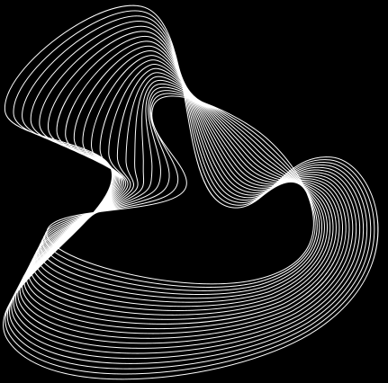

Goldman Sachs
Stock Price Analysis
with Deep Learning
Team 1 Yuanshan Zhang, Mengxin Zhao, Jinke Han

Slide 2
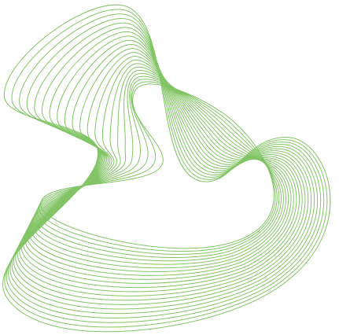
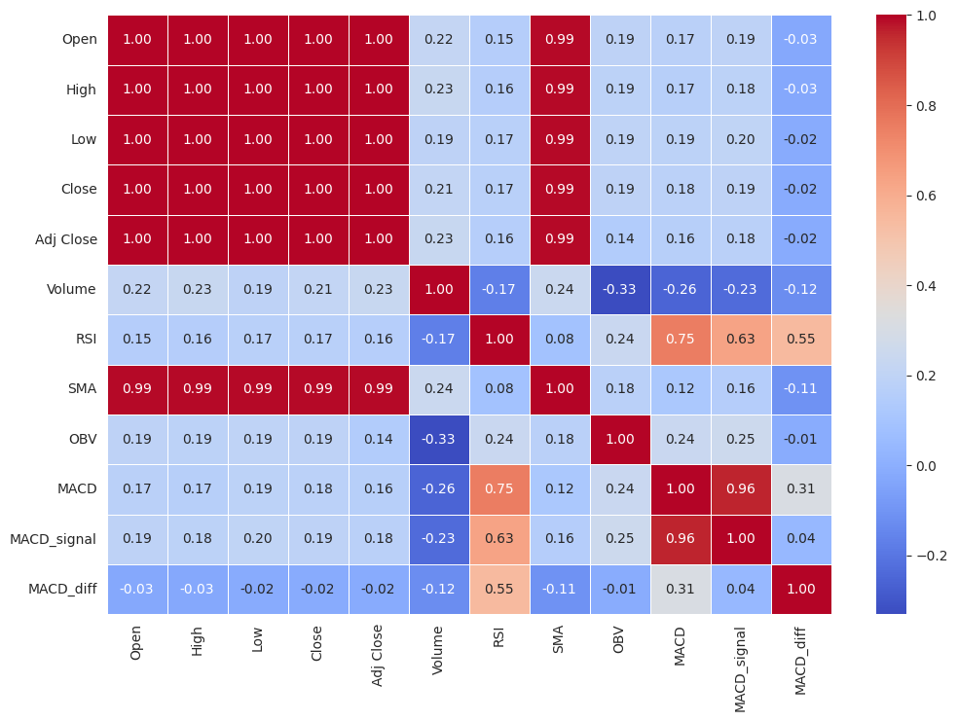
Introduction & Dataset
Our dataset encompasses the historical stock prices of Goldman Sachs Corporation, extending from May 4, 1999, to April 5, 2024. It includes precisely 6,272 entries, representing daily market activity over nearly 25 years.
The primary objective of our project is to predict the stock price of Goldman Sachs using both deep learning and traditional non-deep learning models. Additionally, we aim to employ deep learning techniques to enable the model to make daily trading decisions (buy/sell/hold), with the goal of maximizing overall profit.

Slide 3
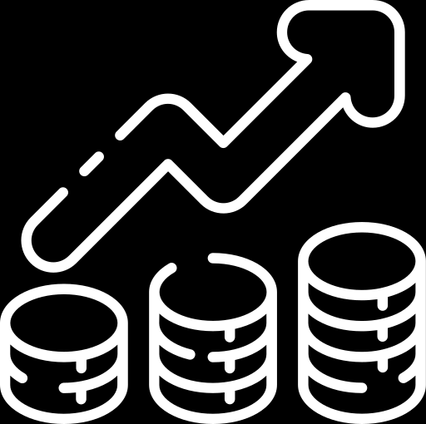
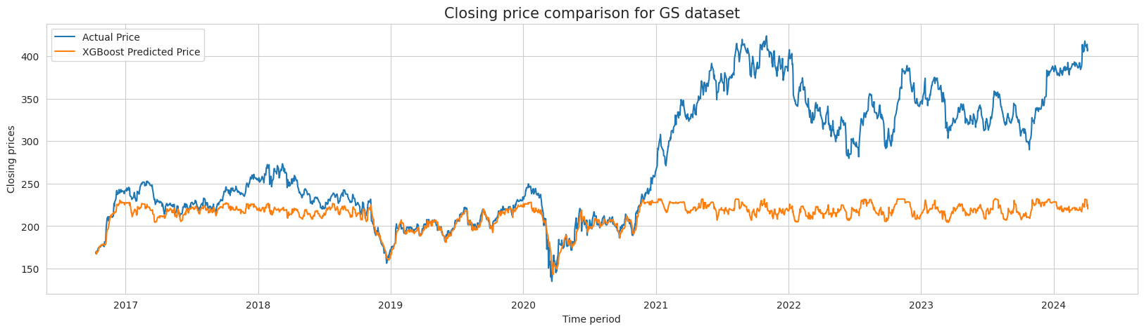
Traditional Model
Train Root Mean Squared Error: 2.96
Test Root Mean Squared Error: 88.38
Train Mean Absolute Error: 2.17
Test Mean Absolute Error: 62.59
Train R-squared: 0.995
Test R-squared: -0.568
XGBoost
Hyperparameter tuning with Random Search

Slide 4
LSTM
X
y
Data Preprocessing
Normalize data
Create time window (100)
Train-Test-Split(0.7)
Features of Day1 to Day 100
Close Price of Day 101
Features of Day 2 to Day 101
Close Price of Day 102
…

Slide 5
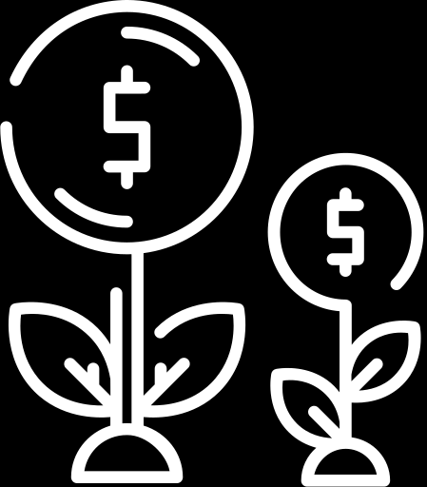
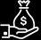


LSTM
Basic Model
With LeakyRelU
LSTM(units=100)
BatchNormalization()
LSTM(units=64, kernel_initializer=he_normal(seed=None)))
BatchNormalization()
Dense(units=1, kernel_initializer=he_normal(seed=None))
model.compile(optimizer='adam', loss='mean_squared_error',metrics=['mae'])
LSTM(units=100)
BatchNormalization()
LeakyReLU(alpha=0.1)
LSTM(units=64, kernel_initializer=he_normal(seed=None)))
BatchNormalization()
LeakyReLU(alpha=0.1)
Dense(units=1, kernel_initializer=he_normal(seed=None))
model.compile(optimizer='adam', loss='mean_squared_error',metrics=['mae'])
Root Mean Squared Error (RMSE): 21.95
Test MAE: 15.05
Root Mean Squared Error (RMSE): 127.09
Test MAE: 103.02

Slide 6
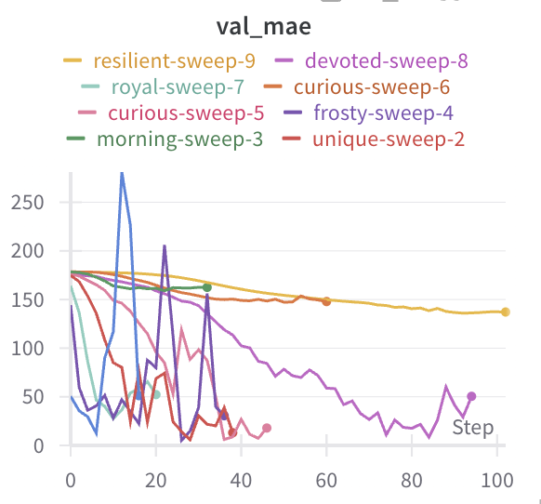
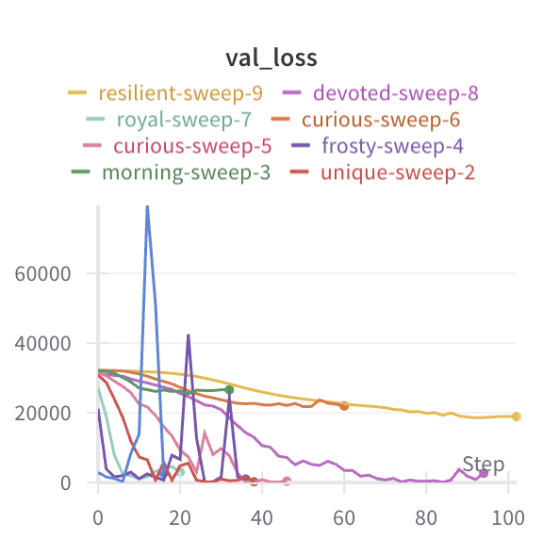
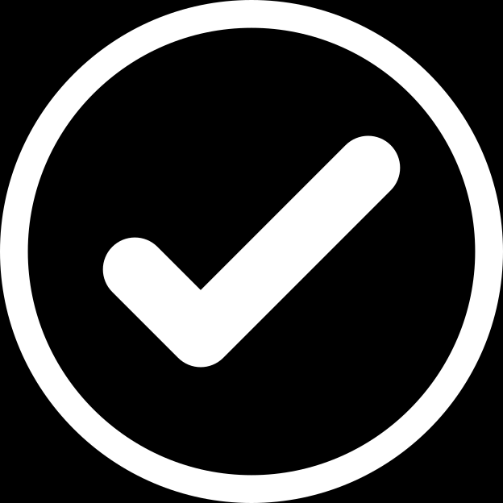
LSTM
Hyperparameter Tuning
method: grid
learning_rate: [0.01, 0.001, 0.0001]
batch_size: [32, 64, 128]
Best model: sweep 2
learning_rate =0.001, Batch_size=32 Val_MAE=3.869, Val_loss:24.329

Slide 7

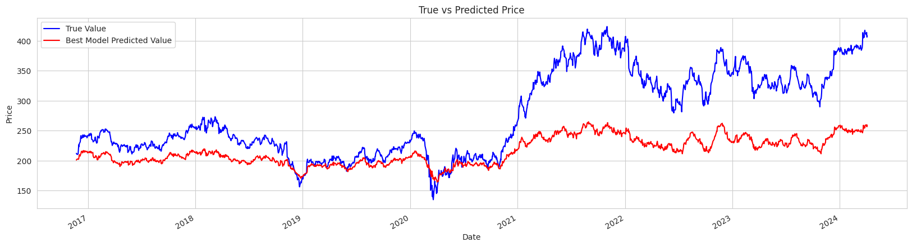
Initial
Research
Seeding
Companies
Company Analysis
test_MAE=29.914，r^2=0.63

Slide 8
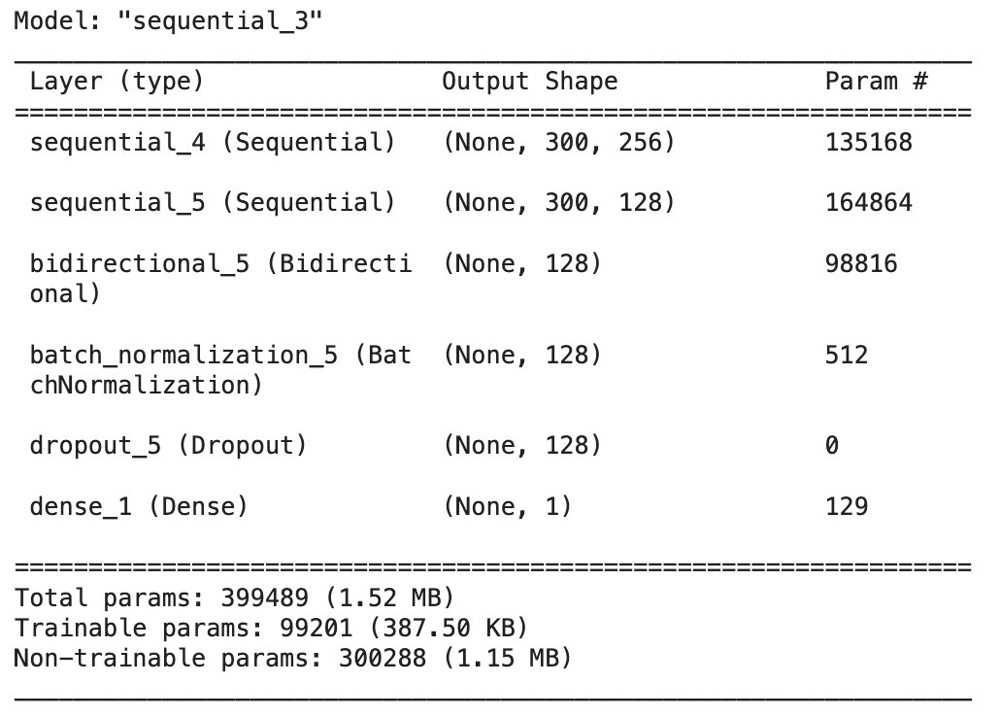
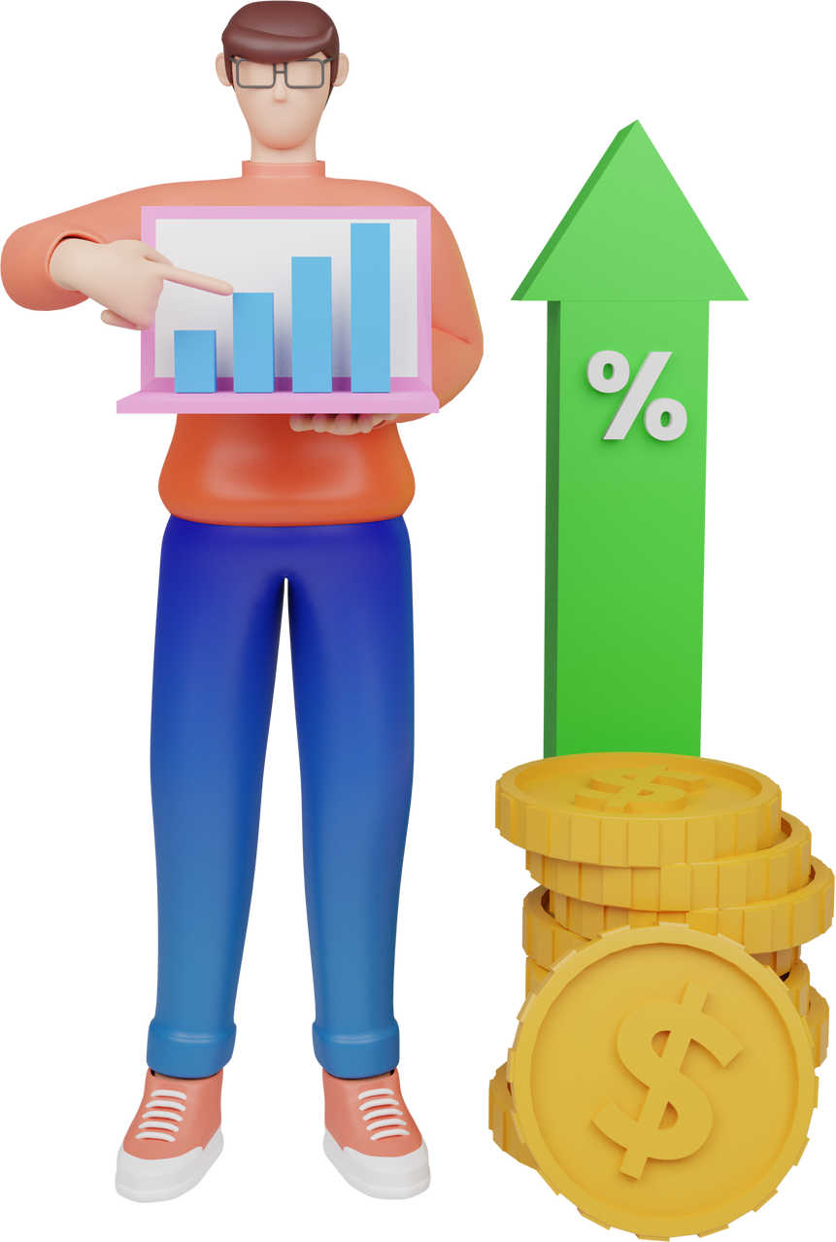
Transfer Learning

Slide 9
Transfer Learning
Freeze

Slide 10
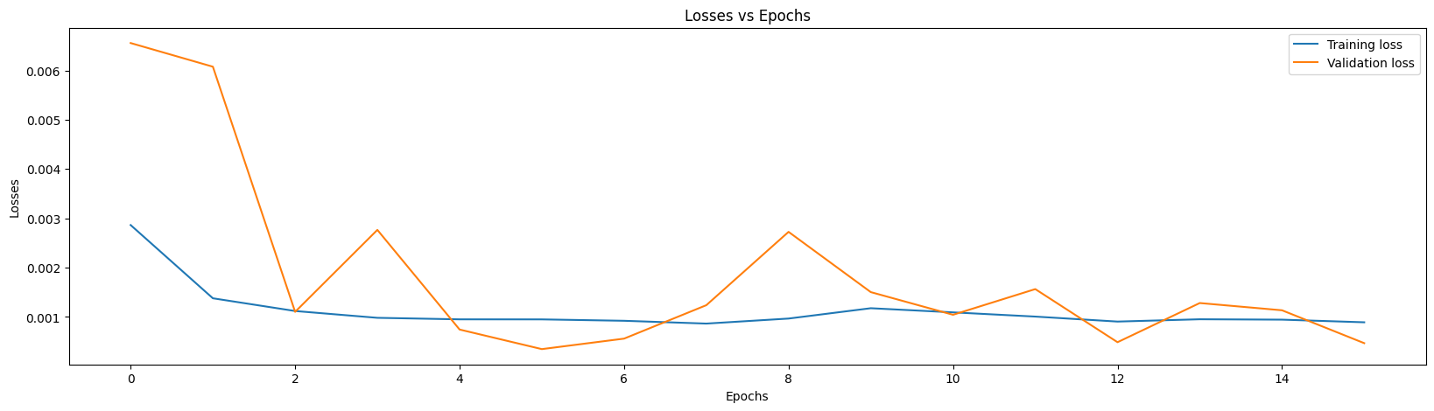

Restoring model weights from
the end of the best epoch: 6.
Goldman Sachs Group Inc.
r2 : 0.24263854706809662

Slide 11
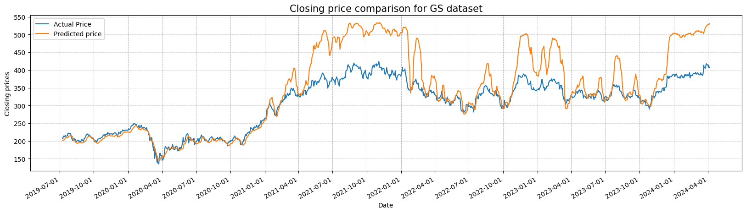
Investors Table
Item Number 1
Item Number 3

Slide 12
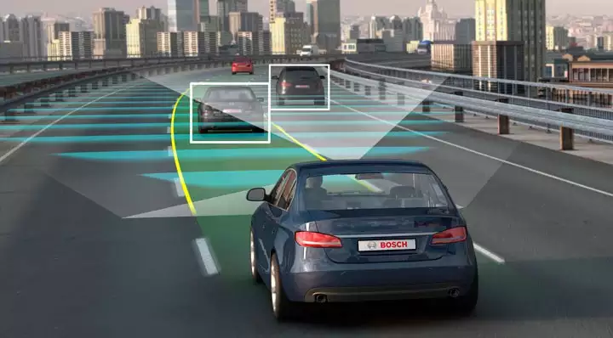

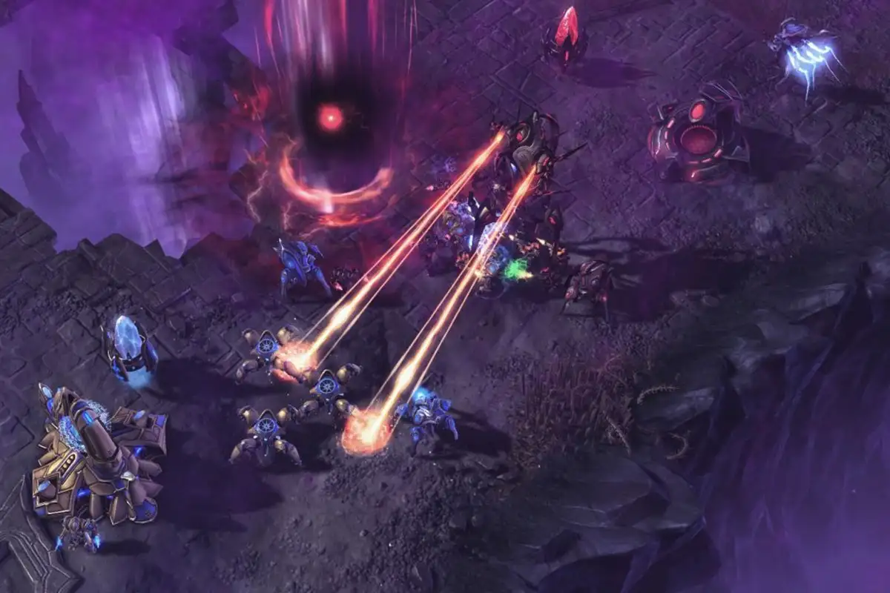
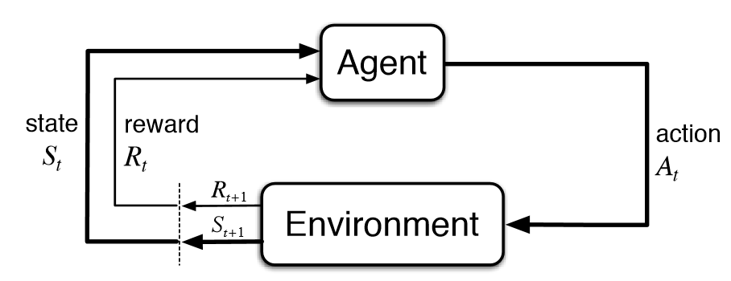
Reinforcement Learning
Notes:
Reinforcement learning is the state of art and most current AI research are focused on RL. It also succeeded in many real-world applications. For instance, auto-driving, the well-known Alpha Go, strategic gaming, and also stock trading. It is substantially different from supervised and unsupervised learning, and is regarded as the ‘third category of machine learning’ because in reinforcement learning, the agent learns by interacting with the environment

Slide 13


Definitions
Transition quintuple - (s, a, r, s’, done)
Agent: the algorithm that can be trained to choose the optimal actions at each state to maximize the total rewards
Environment: a stock trading simulation with which the agent can interact
A - Action: hold, buy, and sell
R - Reward: positive R when profit > 0, negative R when profit < 0
S - State: stock info (sliding window), balance, position, profits
Episode:
s: the current state
a: action based on observation of the current state
r: reward assigned by the environment after taking action a
s’: the next state
done: if the episode is done
Notes:
So, what is an agent and how does it interact with the environment? Let’s bring in the concepts using our scenario. First, an agent is the algorithm that can be trained using RL to learn how to maximize profits in the stock market by taking actions. Actions such hold, buy, and sell are decided by referring to the current state, in our case, stock info, balance, position, and profit. After taking an action, the environment receives the agent’s action and assign rewards to it. Reward is a designed mechanism, for instance, we assign positive reward to the agent when profit>0 and negative reward when profit<0. So, the process can be summarized as, at state0, the agent takes action0, the environment assigns reward 1 to the agent, and moves to the next state S1. The interaction keeps going on until reaching the end of trading window, forming an entire episode. So, at each state, a transition quintuple is formed and is used to estimate the Q value using reinforcement learning.

Slide 14

What is Q?
DQN (Deep Q Network)
Q(s,a) is the expected return of taking an action a at state s
With full knowledge of the environment, Q is calculated by Bellman’s equation
Large or continuous state space, impossible to calculate and store all Q values
Approximate Q and target using a DNN
Model-free algorithm that does not require full knowledge of the environment
Notes:
So what is Q? But in stock trading, the state space is large (the stock market is changing every second) and the full knowledge of the environment is impossible to gain (no one knows what tomorrow's’ stock market will look like), so we chose the deep Q learning, which is a combination of model-free reinforcement learning and deep neural network algorithm, and model-free means that DQN is able to learn the best behavior directly from the action without the necessity of the full knowledge of the environment.

Slide 15
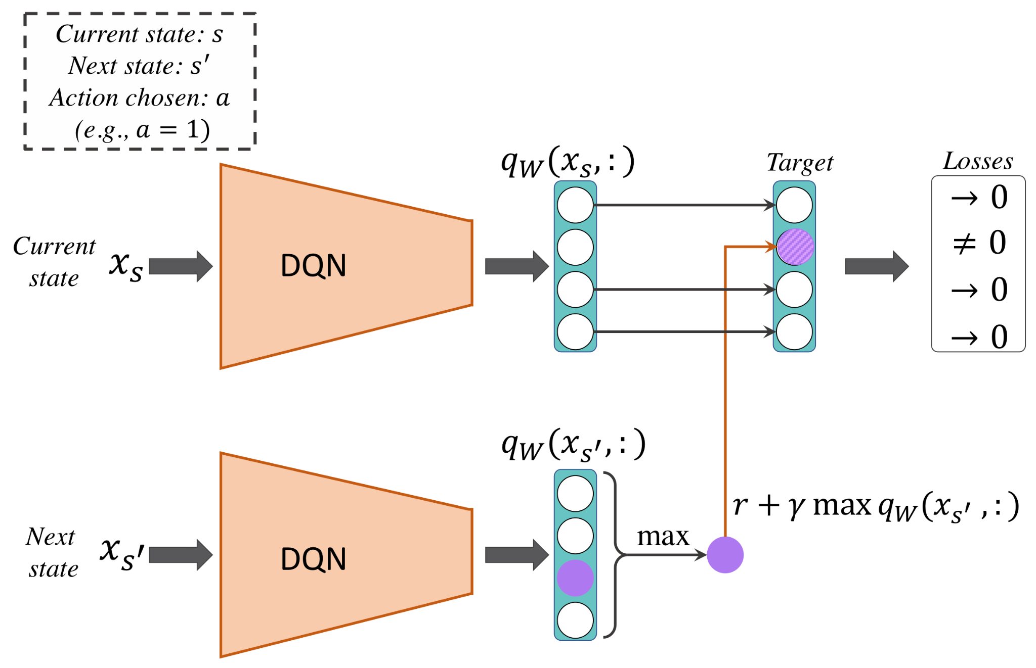
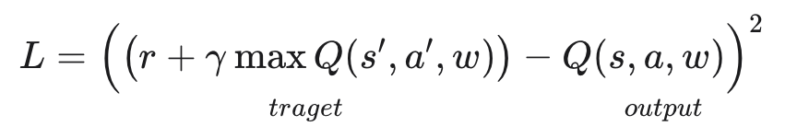
DQN (Deep Q Network )
Notes:
Since we are not able to calculate the ground truth of Q without full knowledge of the environment, we use DNN (in our case, MLP and LSTM) to estimate Q as well as the ground truth. Here, both estimation and ground truth are estimated through the same network, but the input is different. The input for estimation is the current state, and the input for ground truth estimation is the next state. After estimation, the loss function is formed and gradient descent can now be applied.

Slide 16
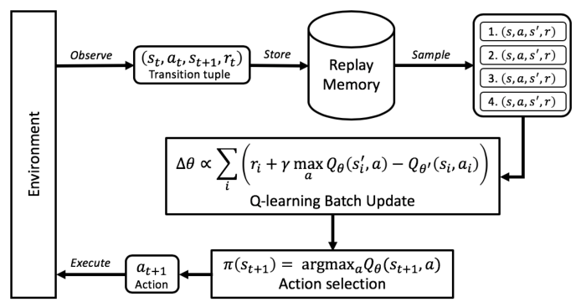
Replay memory
Notes:
Finally, a replay memory is used to store quintuples, and at each state, number of batch size quintuples are sampled to estimate the Q-values.

Slide 17
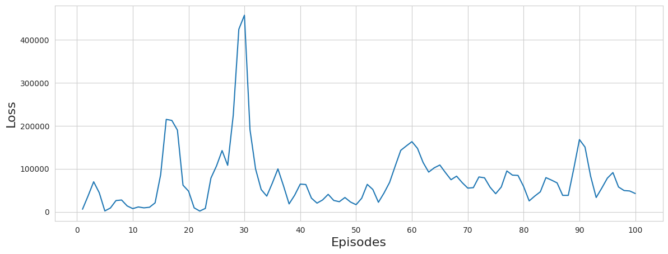
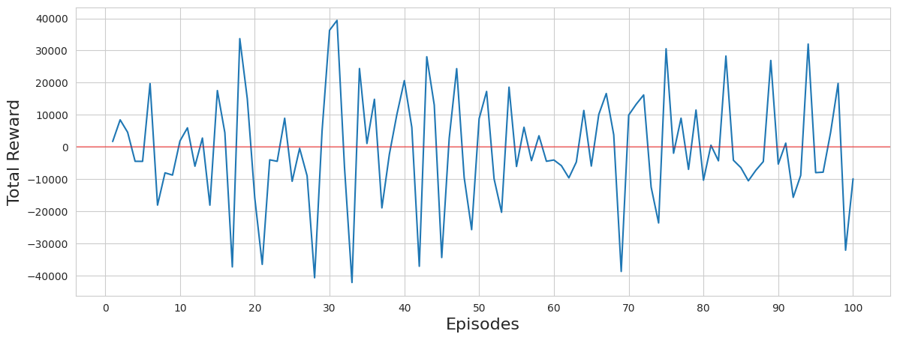
Experiment Result of DQN with LSTM
Test reward: 19310.4821, Total profit: 19310.48210144043
Notes:
From the experimental results, we can see that the loss and total reward are far from converging. This is because for a complex task, it usually takes the agent thousands to millions of episodes to converge, and we only have the time to run 100 episodes. Because it is not converging, the 19,000 dollars that the agent made can only be attributed to luck. Moreover, the price data and simplified trading logic are far from enough for the agent to develop sophisticated trading strategies. Incorporating other data sources, for instance, news, would also greatly help the convergence.

Slide 18
Challenge：
Stock prices are affected by a variety of factors, including market sentiment, economic indicators, political events, etc., which may not be adequately accounted for in current models.
Model selection criteria
Designing the environment and reward mechanism
Theoretical understanding of DQN and finance
Running DQN experiments is extremely computationally exhausting

Slide 19

Thank
you ！

